Slide 1

Overview for parks staff on
Park Prescription programs

Slide 2
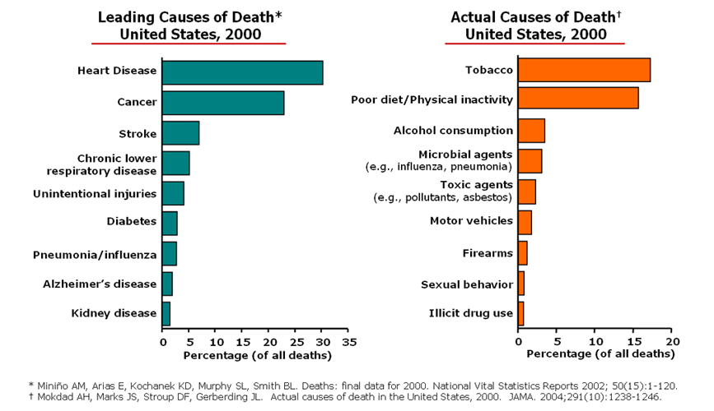
Physical Inactivity

Slide 3
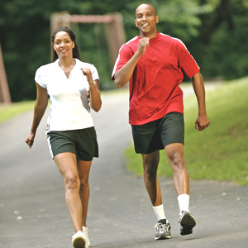
Physical Health Benefits of Nature
Physical activity
Obesity
Benefits of green exercise
Vitamin D
Myopia
Longevity

Slide 4
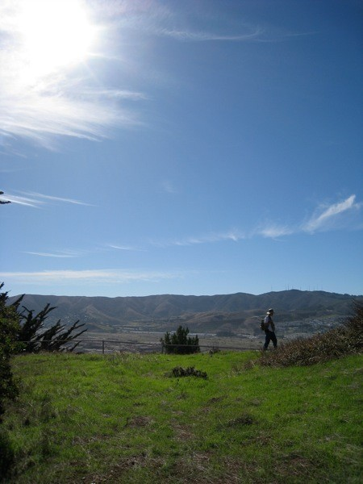
Mental Health Benefits of Nature
Stress
Anxiety
Depression
Trauma
ADHD
Notes:
- Well-being improved for Australians who found their surroundings to be highly green (N 1,895, Sugiyama, 2008)
Physician-diagnosed anxiety reduced amongst those living in places with greenspace (N 345,000, Maas, 2009)
Physician-diagnosed depression reduced in areas with increased green cover (Ulrich, 1991)
Randomized trial comparing a walk in a park to a walk in an urban setting. Kids walking through the park had improved concentration comparable to medication effect. (Taylor, 2009)
Parents rate activities conducted in green settings as being more helpful on ADHD symptoms than those conducted indoors or in areas without vegetation (Kuo 2004)

Slide 5
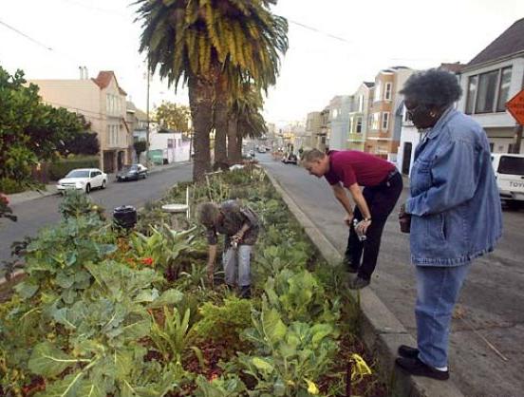
Community Benefits of Nature
Economic
Crime, aggression
Social integration
Sense of place
Environmental stewardship

Slide 6
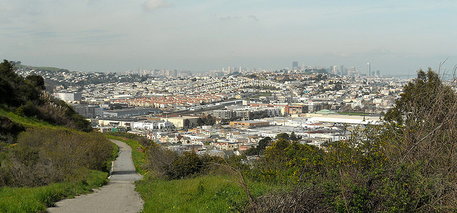
Common Barriers to Outdoor Time
Time
Access
Not feeling comfortable, welcome

Slide 7
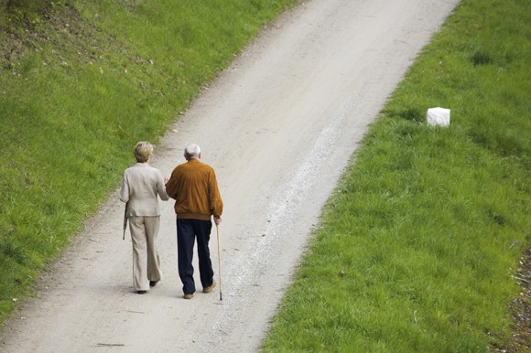
Be Prepared for Higher Health Needs Visitors
Allergies
Asthma
Multiple social-stressors
Mental health, depression, anxiety PTSD
ADHD
Obesity

Slide 8
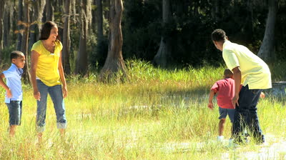
Expectations
Encourage long time relationship with the park
Fun and enjoyable
Encourage stewardship
Create a relationship with a space in the neighborhood

Slide 9
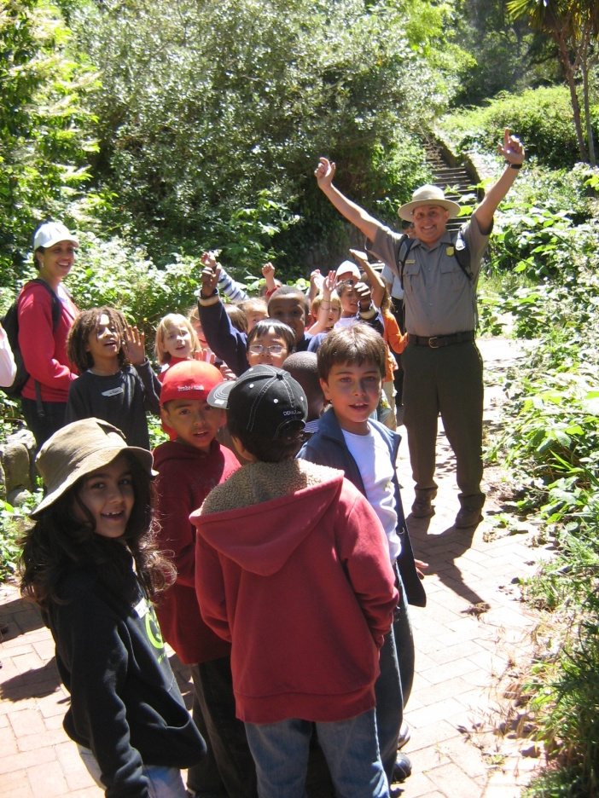
Messaging Park Prescriptions
Create a “warm welcome” for first time visitors
Use clear, introductory level words and phrases
Be sensitive to the participants constraints
Empower each person to “own their park”

Slide 10
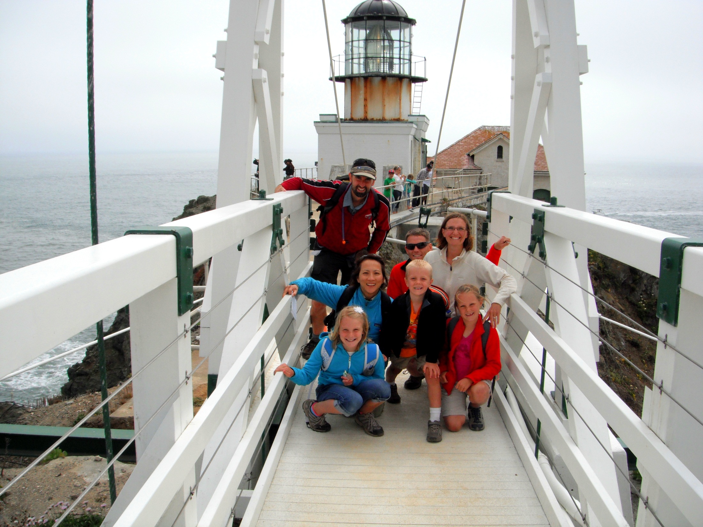
Park Prescription Program Surveys
Understand demographics
Understand perceived values of park
Getting head counts

Slide 11
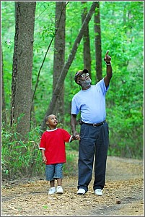
Conclusion
Meet people where they are at:
    Build on their own outdoor experiences and be sensitive to their needs and barriers
Parks and health are allies:
    We share the same goal of a healthy, active Bay Area
Make it fun and enjoyable!

Slide 12
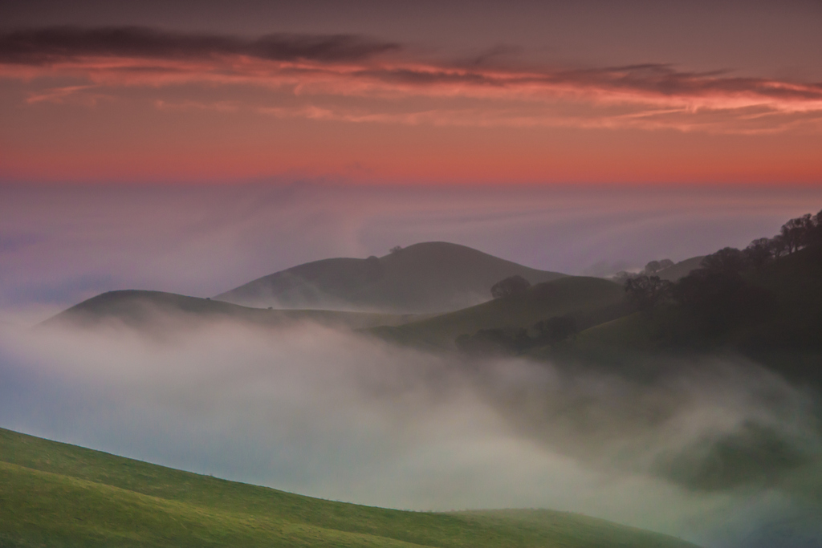
See you in the parks!

